Slide 1

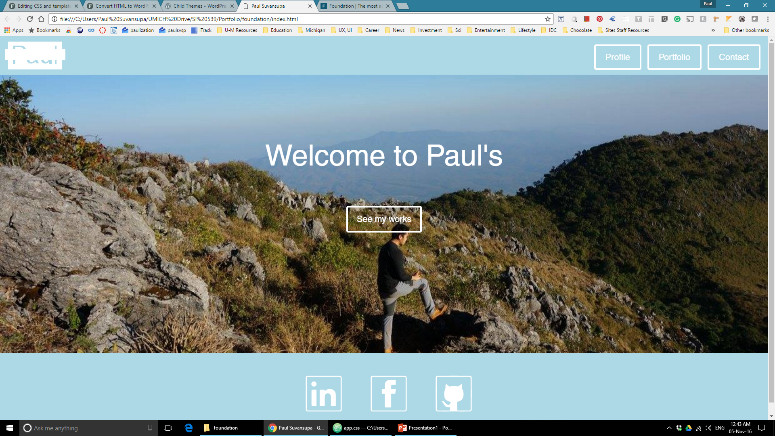
Index.html
Should be like this sample
I use jquery to apply background color to current page <a>, which result in this white thick cross. Please remove it.
These should be truly centered

Slide 2

Index.html
Profile
Portfolio
Contact
For 425px> width, do this

Slide 3
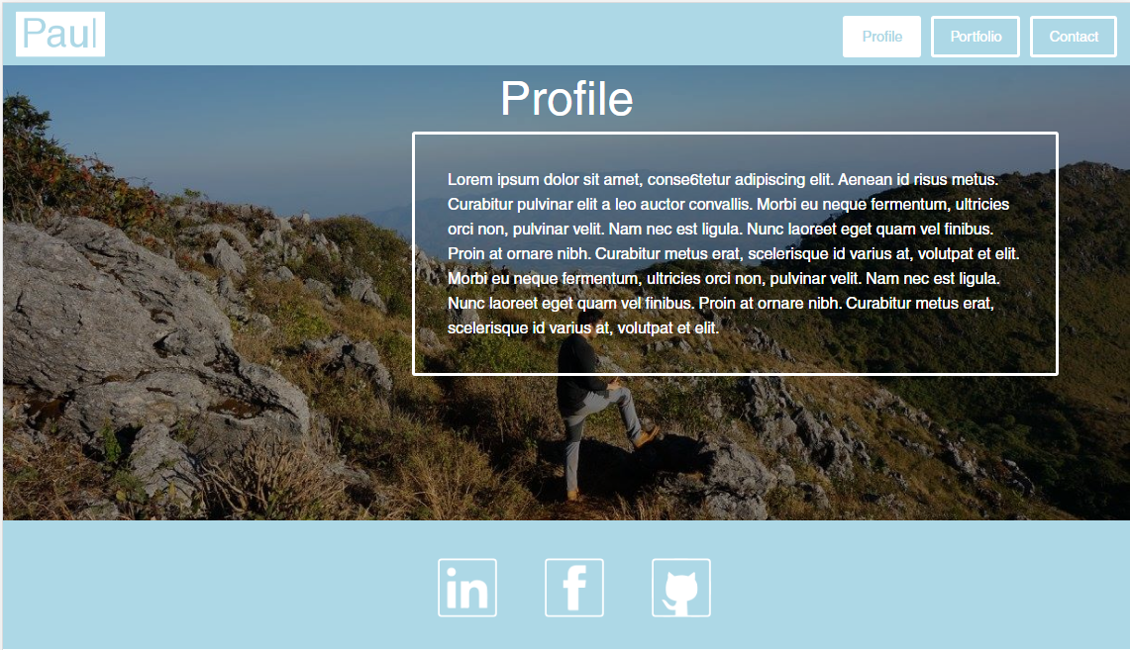
profile.html
Insert a place holder for image. Ensure that when I insert image here, it wont go out of this size (check responsiveness also)

Slide 4
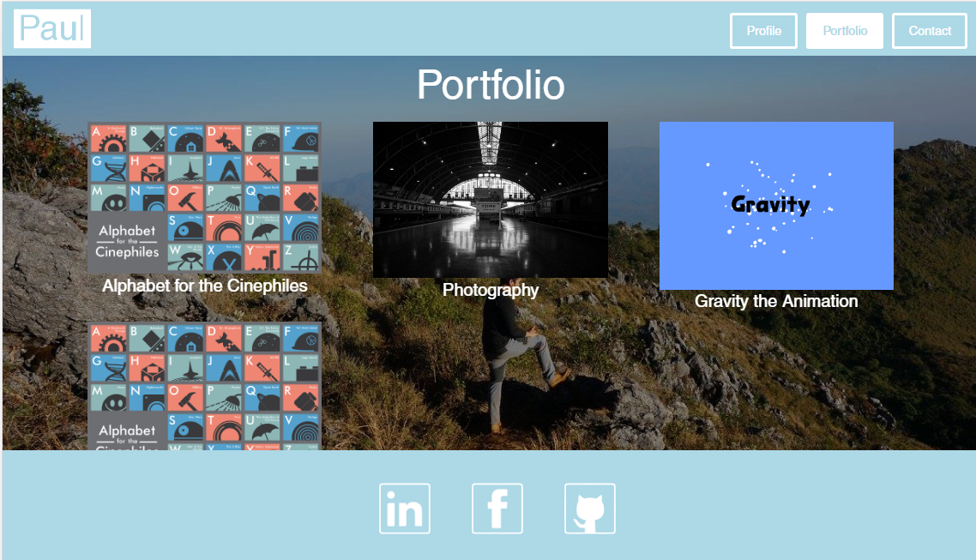
portfolio.html
These img box must have the same size

Slide 5
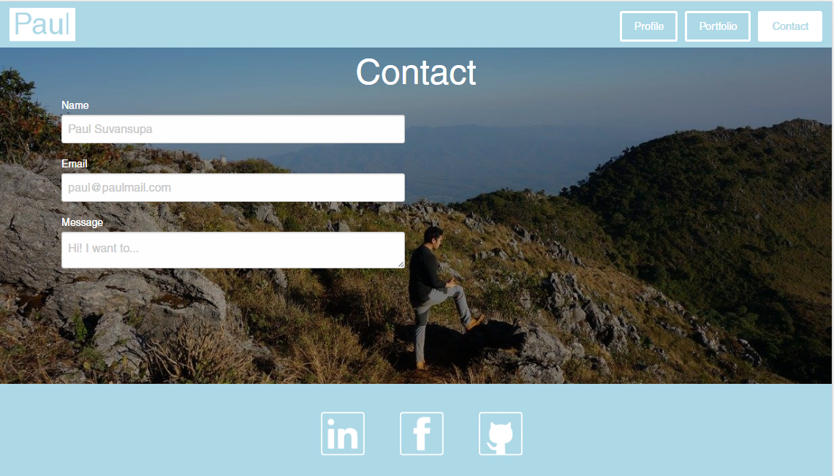
Center these please

